Slide 1
Navy Suicide Prevention Program
Training for Suicide Prevention Coordinators (SPCs)
Released by Suicide Prevention Program, OPNAV N170
UNCLASSIFIED

Slide 2


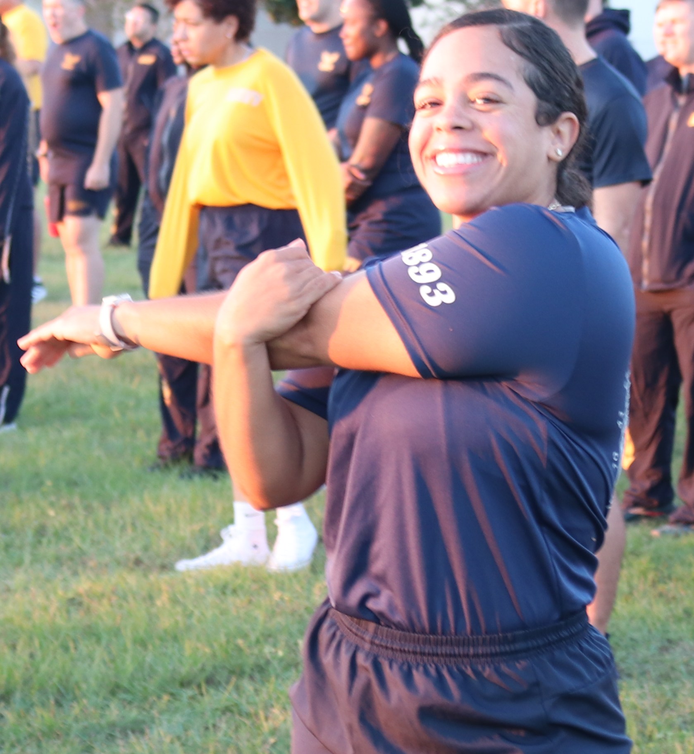
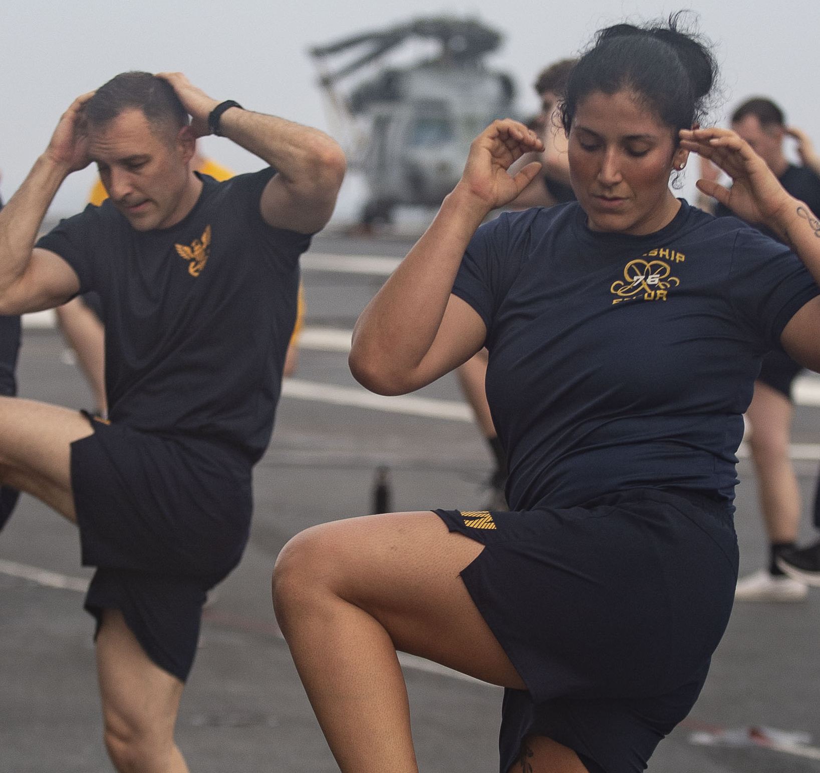
Navy Suicide Prevention Branch
OPNAV N170B is the Suicide Prevention Branch within the Navy Culture and Force Resilience Office.
Our Suicide Prevention program provides policies, resources and support to the fleet, helping to foster an organizational climate that supports and develops leaders, builds resilience and encourages Total Sailor Fitness.
The goal of the Navy Suicide Prevention Program is to reduce suicides by enabling Sailors— through knowledge, personal responsibility and resources—to thrive as a psychologically healthy, resilient and mission- effective force

Slide 3
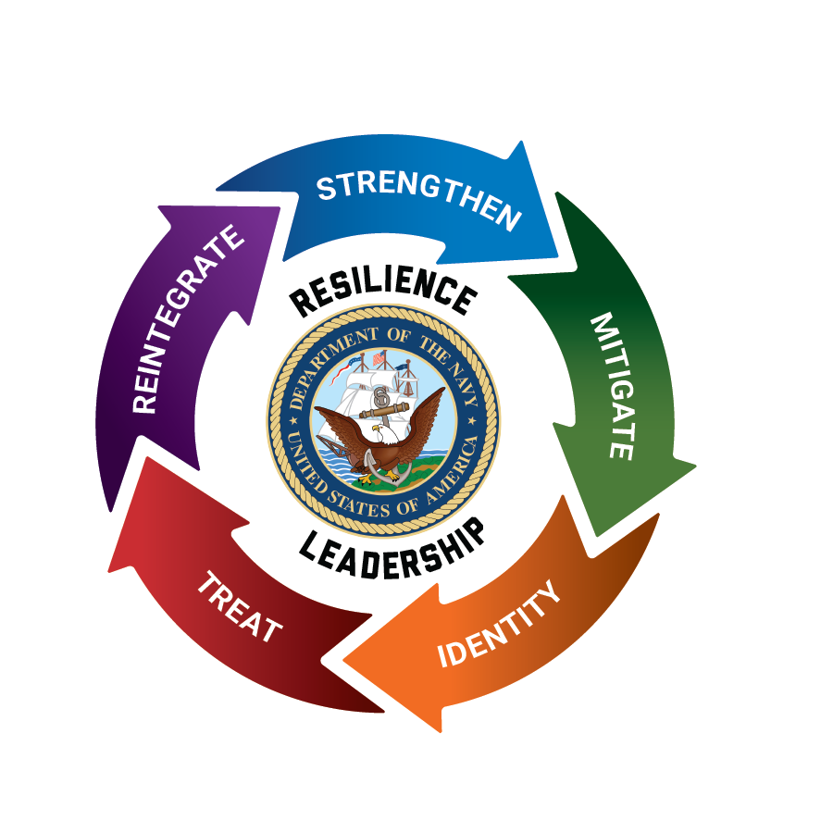
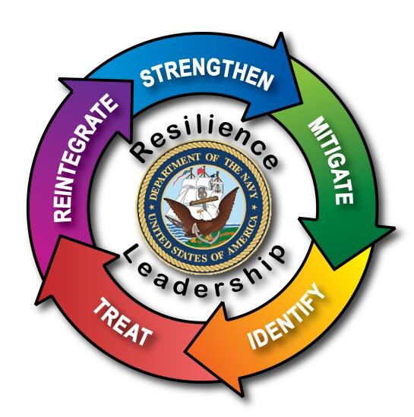
Objectives
Responsibilities
Reporting requirements
Suicide Risk/Protective Factors, Warning signs
Crisis response plan
Lethal Means Safety (LMS) Plan
Reintegration
Postvention
DODSER
Sailor Assistance and Intercept for Life (SAIL)

Slide 4
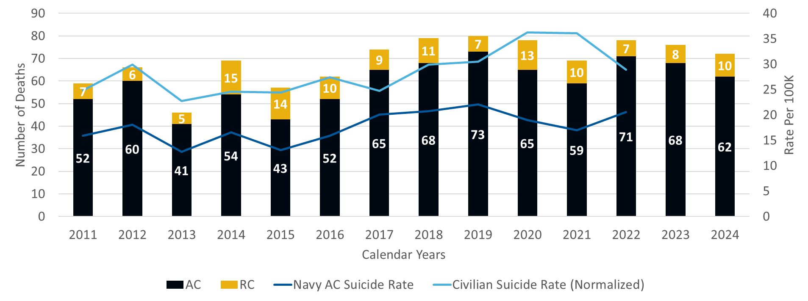
Suicide Snapshot
Rate per 100k | 2011 | 2012 | 2013 | 2014 | 2015 | 2016 | 2017 | 2018 | 2019 | 2020 | 2021 | 2022
Navy AC Suicide Rate | 15.9 | 18.1 | 12.7 | 16.6 | 13.1 | 15.9 | 20.1 | 20.7 | 22.1 | 19.0 | 17.0 | 20.6
Civilian Suicide Rate (Normalized) | 24.8 | 29.9 | 22.7 | 24.6 | 24.4 | 27.4 | 24.7 | 29.9 | 30.5 | 36.2 | 36.1 | 28.9

Slide 5
Relevant and Related Policy
TITLE | DESCRIPTION
OPNAVINST 1720.4B | Navy Suicide Prevention Program
OPNAVINST 5354.1G | Navy Equal Opportunity Program
SECNAVINST 1730.9 | Confidential Communication to Navy Chaplains
OPNAVINST 3100.6 | OPREP/SITREP Reporting Requirements
DODI 6490.04 | Mental Health Evaluations of Service Members
DODI 6490.08 | Command Notification Requirements in Providing Mental Health Care
OPNAVINST 6100.2A | Health Promotion/Life Skills
NAVADMIN 027/17 | Sailor Assistance and Intercept for Life Update
NAVADMIN 208/16 | Suicide Prevention and Response: Sailor Assistance and Intercept for Life
NAVADMIN 021/21 | Sailor Assistance and Intercept for Life Update
NAVADMIN 263/14 | Guidance for Reducing Access to Lethal Means

Slide 6
Responsibilities: Commanding Officers
Foster a command climate that supports and promotes psychological health and overall wellness, and communicates regular messages to promote available resources
Establish and maintain an effective suicide prevention program consistent with OPNAVINST 1720.4B
Designate an SPC in writing (inspection item) who demonstrates trustworthiness, maturity and is an advocate for help seeking
Work with SPC/key personnel to develop a written crisis response plan (test annually at minimum)
Ensure command notifies SPC when Sailor exhibits SRB
Establish lethal means safety measures and be familiar with procedures for emergent mental health evaluations, command directed evaluations and communications with providers
In the event of a suicide, complete the Dept. of Defense Suicide Event Report (DoDSER) within 60 days of notification from OPNAV N170B
Every leader has a responsibility to foster a command climate that encourages Sailors
to seek help, receive help and be welcomed back to the unit.

Slide 7
Responsibilities: SPCs
SPCs must receive required training as established by OPNAV N170B within 90 days of designation by their commanding officer in writing. SPCs will:
Be thoroughly familiar with OPNAVINST 1720.4B requirements, serve as an adviser to the command and meet with/brief Triad no less than twice per year.
Ensure educational materials, resources and leadership messages are accessible throughout command.
Schedule and announce suicide prevention training and be prepared, as needed, to conduct training (ensure the facilitator has the most up-to-date materials and requirements).
Ensure the crisis response plan is current and tailored to each command’s unique characteristics. Crisis plan must include lethal means plan, local resources, procedures for safely transporting an immediate-risk person, procedures for responding to concerning social media content and assisting a distressed caller.
Be familiar with and execute SAIL, DoDSER and other reporting procedures as specified in OPNAVINST 1720.4B. Establish relationship with medical DoDSER POC.
Collaborate with other SPCs and program managers (UPCs, DAPAs, CFLs, etc.), be a member of the Command Resilience Team and meet quarterly per OPNAVINST 5354.1G and NAVADMIN 222/19 tailor OPNAV N170B resources to command efforts.

Slide 8
Responsibilities: Echelon 2 & 3 SPPMs
Echelon 2 and 3 commands must assign an SPPM. SPPMs should be E7 or above, or GS 9 or above, and will provide proactive and consistent suicide prevention program policy guidance and training to subordinate commands. Once a SPPM is assigned, commands must provide the individual’s name and contact information to OPNAV N170B via
emailto suicideprevention@navy.mil or via telephone at (901) 874-6613.
SPPMs will:
Receive OPNAV N170F training within 90 days of designation
Ensure subordinate commands comply with OPNAVINST 1720.4B (go over SP Program Checklist)
Ensure each subordinate command has an OPNAV-trained SPC and letter of appointment, and maintain a roster of subordinate command SPCs
Coordinate the revision and development of Navy Suicide Prevention Programs and policies with OPNAV N170B
Disseminate suicide prevention program information to subordinate commands Assist subordinate command SPCs and ensure they meet all program requirements as set forth in the OPNAVINST1720.4B, including maintaining a up-to-date crisis response plan
Maintain historical data on all suicides, SRBs and Sailor Assistance and Intercept for Life (SAIL) referrals
Provide guidance and oversight of annual GMT

Slide 9
Suicide Prevention CMT
Per OPNAVINST 1720.4B all Suicide Prevention training must adhere to the DOD Suicide Prevention Training Competency Framework. CMT is available at https://www.mynavyhr.navy.mil/ At minimum, training must include:
Basic education on suicide, including an emphasis that anyone can be at risk
Recognition of risk factors, warning signs, and protective factors
Familiarization with “Ask, Care, Treat” to facilitate early intervention when a Sailor may be at risk for suicide or is experiencing difficulty
Protocols and resources for responding to crises (local crisis response plan) involving those who may be at high risk for suicide
How to practice lethal means safety (in home storage and voluntary storage of personally owned firearms, proactive prescription drug disposal, etc. )
Postvention actions following a death by suicide to promote healing and return to Mission-readiness
100% confidential communications to Navy chaplains

Slide 10
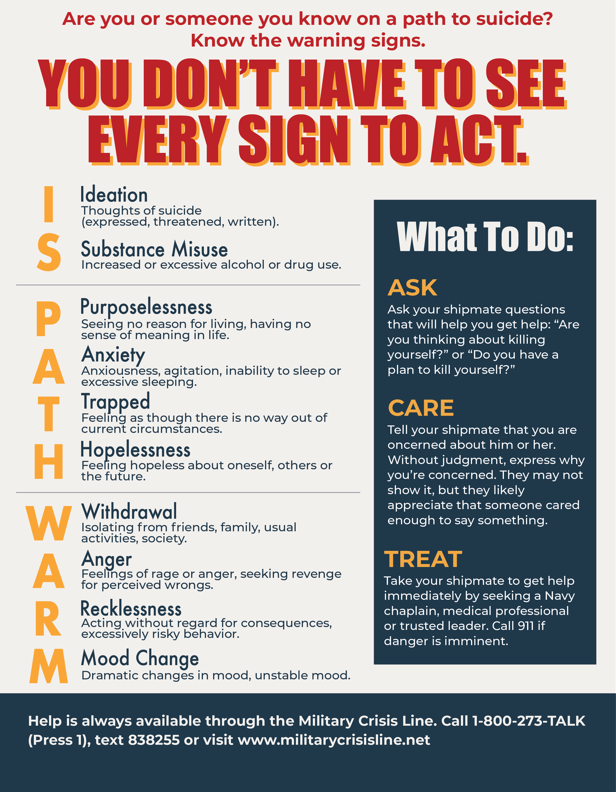

Recognizing Risk in Sailors
Suicide can’t be predicted, but it can be prevented.
LISTEN TO YOUR SAILOR
THINGS TO LOOK FOR
“I give up.”
“This isn’t worth it. I’d rather be dead; you’re better off without me.”
“I can’t do anything right.”
“I can’t believes/he hurt me this way. It hurts too bad.”
Drastic changes in behavior
Declining self-care (weight loss or gain, disheveled appearance)
No future plans, seems to have given up
Social media posts with increasing images of alcohol, weapons, and feelings of loneliness and rejection

Slide 11
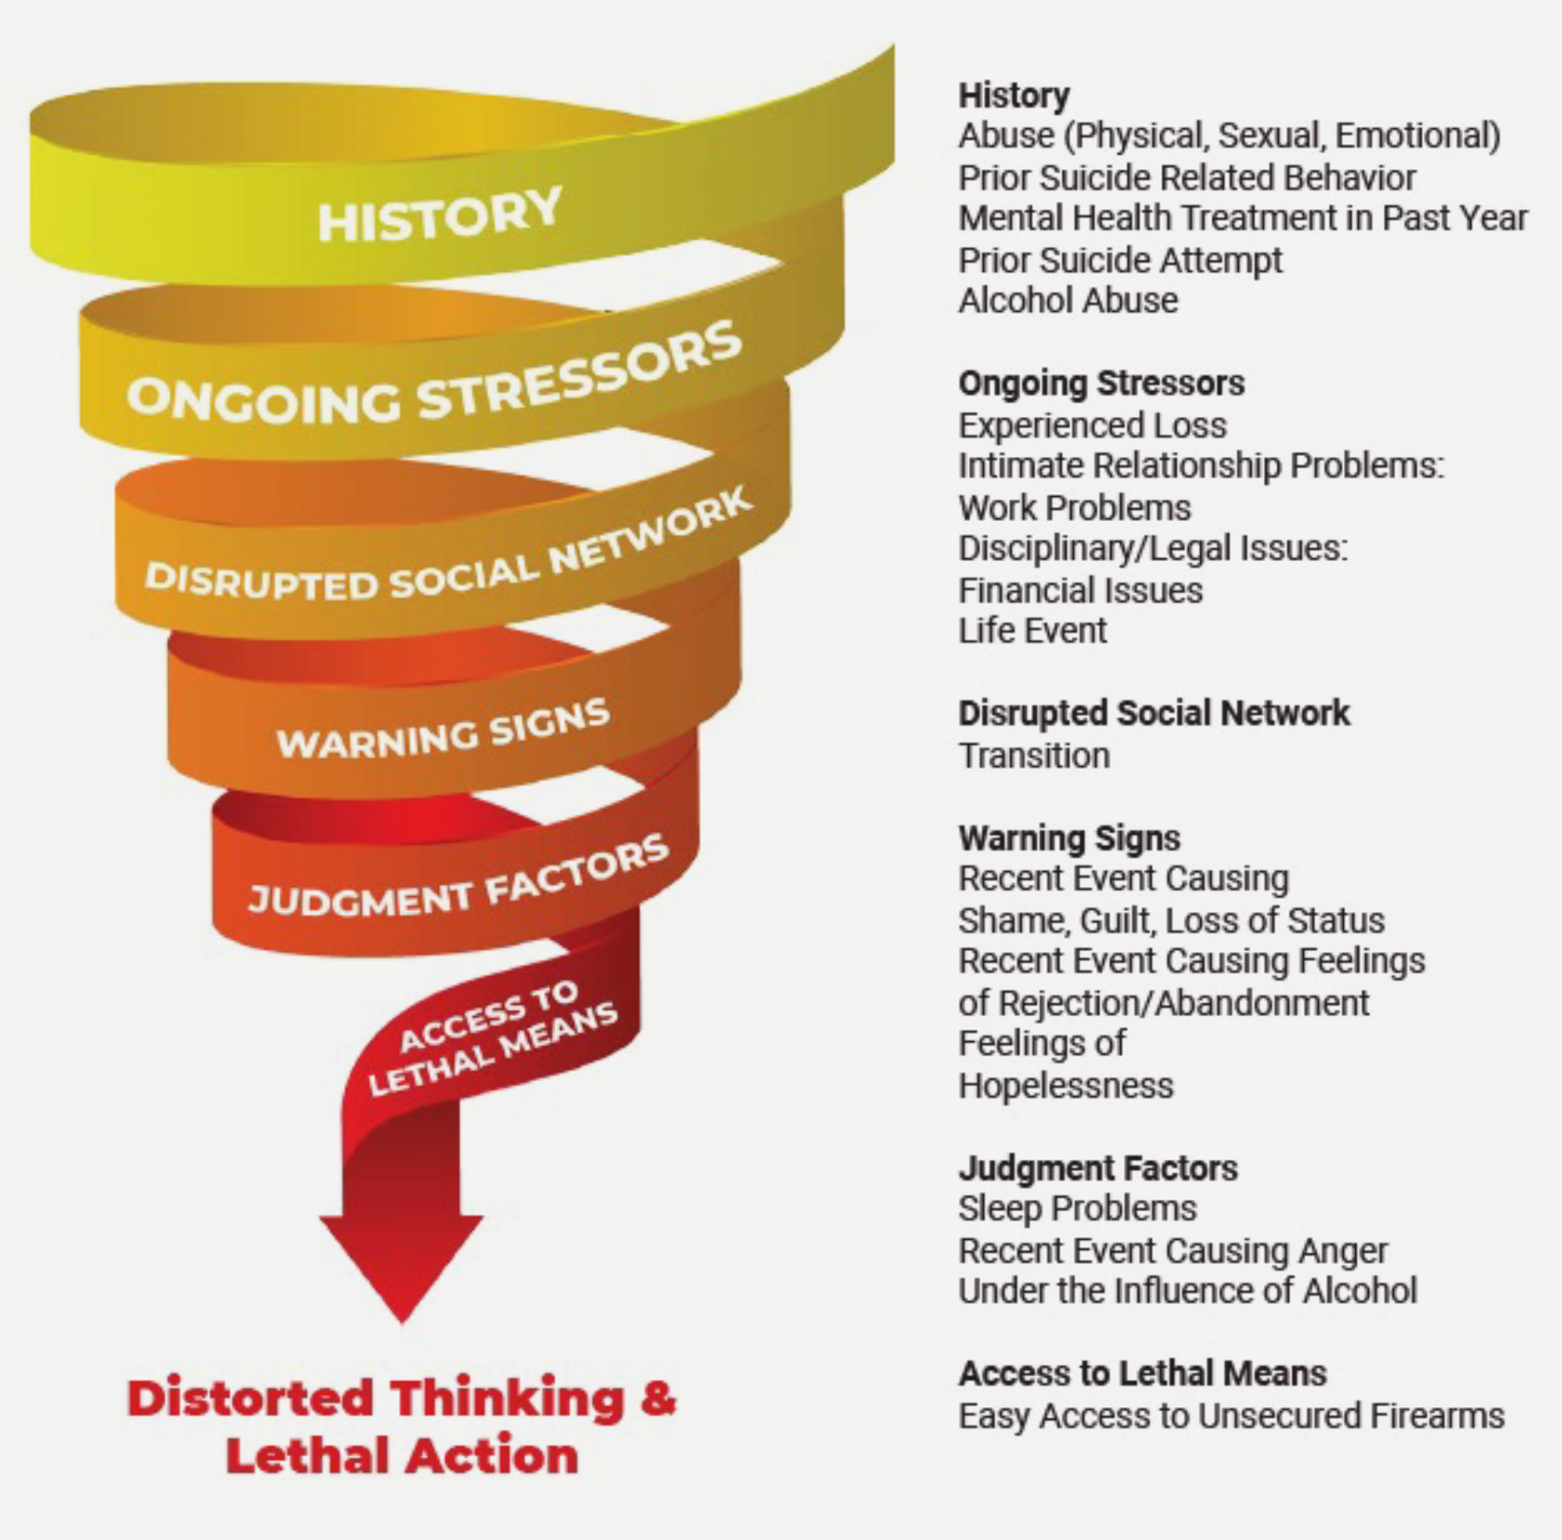
Connecting the Dots: Who Is At Risk?
History
Abuse (Physical, Sexual, Emotional)
Prior Suicide Related Behavior
Mental Health Treatment in Past Year
Prior Suicide Attempt
Alcohol Abuse
Warning Signs
Recent Event Causing Shame, Guilt, Loss of Status
Recent Event Causing Feelings of Rejection/Abandonment
Feelings of Hopelessness
Ongoing Stressors
Experienced Loss
Intimate Relationship Problems:
Work Problems
Disciplinary/Legal Issues:
Financial Issues
Life Event
Judgement Factors
Sleep Problems
Recent Event Causing Anger
Under the Influence of Alcohol
Access to Lethal Means
Easy Access to Unsecured Firearms
Disrupted Social Network
Transition
Notes:
CAN WE KEEP THE WORDS IN THE BUBBLES BUT ON A LESS BUSY SLIDE? OTHERWISE DELETE
[Nicole]: Does this version clean it up enough?
(Leah) SO much better than the previous layout! Thanks!

Slide 12

Barriers to seeking help:
Desire for self-reliance
Society portrayal and culture
Judgment, lose trust of leaders
Negatively impact career
Lose security clearance
Loss of privacy, gossip
Perceived as weak
“Get over it” attitudes
Lack of awareness of resources

Slide 13
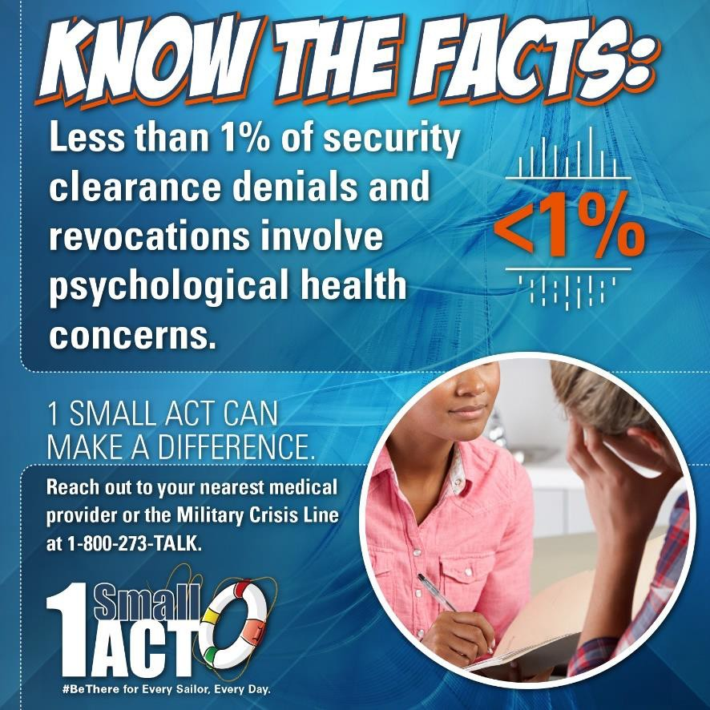
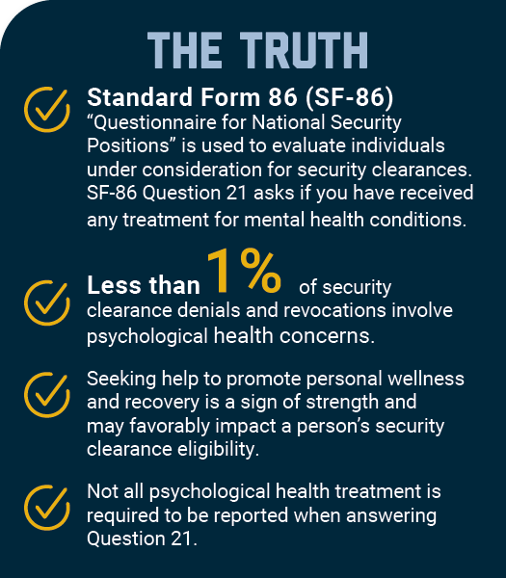
Protective Factors
Protective factors promote healthy stress navigation and good coping skills.
Strong sense of community, healthy relationships, command climate that supports and promotes help seeking
Belonging, purpose and fulfillment
Spirituality
Good problem solving, coping skills, comprehensive wellness and self-care
Access to health care and other local resources
Practicing lethal means safety

Slide 14
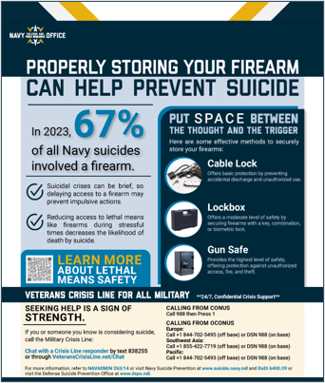
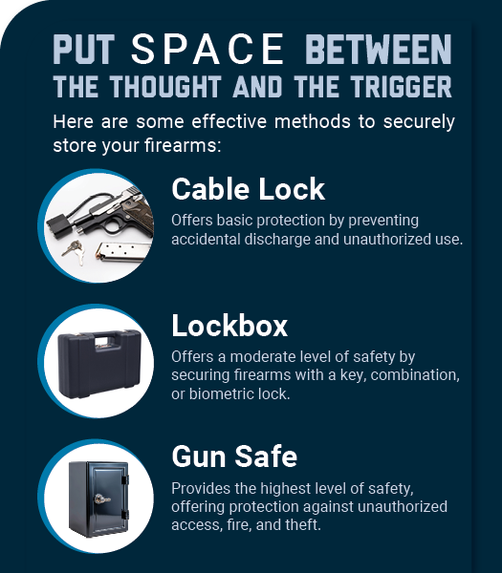
Lethal Means Safety
Research shows that the likelihood of an impulsive suicide attempt decreases when lethal means are out of reach during high-risk periods.
Includes firearms, some prescription medications and structural hazards (shower curtain rods, ropes, cords, etc.).
Firearms are the most common method of suicide in the U.S. and the military due to access and high lethality.
Commanders and health professionals may ask Sailors who are reasonably believed to be at risk for suicide or causing harm to others to voluntarily allow their privately-owned firearms to be stored for temporary safekeeping by the command.
Emphasizing lethal means safety is not about discouraging firearm use or rights
Encourage Sailors to properly dispose of unused prescription drugs via at-home procedures or drop box disposal at their MTF (select locations).

Slide 15
Reporting Requirements: DODSER
 | OPREP Unit SITREP (1 hour) | OPREP Navy Blue (1 hour) | Personnel Casualty Report (4 hours) | SAIL Referral* * (see below) | DoDSER (see below)
Suicide-related Behavior | ✓ |  |  | ✓ | *
Death by Suicide |  | ✓ | ✓ |  | ✓
Reporting requirements apply to uniformed service members only (active and reserve)
DoDSER timeframe begins once Armed Forces Medical Exam Systems (AFMES) has made official determination as to whether suicide is the manner of death. OPNAV N170B will contact the command and inform them of AFMES’ determination.
  If an SRB is classified as a suicide attempt by a medical authority, a DoDSER is required to be completed by the MTF that provided the assessment or the MTF that referred the Sailor to a civilian health care facility.*
Upon AFMES confirmation of suicide as the manner of death, COs are to establish a local Suicide Event Review Board at the command.
  Board must complete a Suicide Event Review Board Charter and utilize the DoDSER Submission Checklist as a guide for potential resources to ensure thorough reporting.

Slide 16
Crisis Response Plan
OPNAVINST 1720.4B requires all commands to develop and maintain a documented and tailored crisis response plan to appropriately respond to psychological health emergencies. This plan should be updated no less than annually and tested to ensure familiarity.
Key considerations include:
Access to medical treatment facilities and resources when in homeport vs. Foreign port, shore installation vs. afloat command
Immediate environmental precautions such as reducing access to lethal means of suicide (includes establishing local storage procedures)
Procedures for conducting safety watch and transporting an immediate-risk person to appropriate medical personnel and/or facilities for evaluation
Procedures for responding to concerning social media, text or email content and assisting a distressed caller (or someone who calls the command out of concern for a Sailor). Ensure training for all pertinent personnel such as QD/CDO/OOD/duty section leaders
Responding to an SRB including SAIL referral

Slide 17
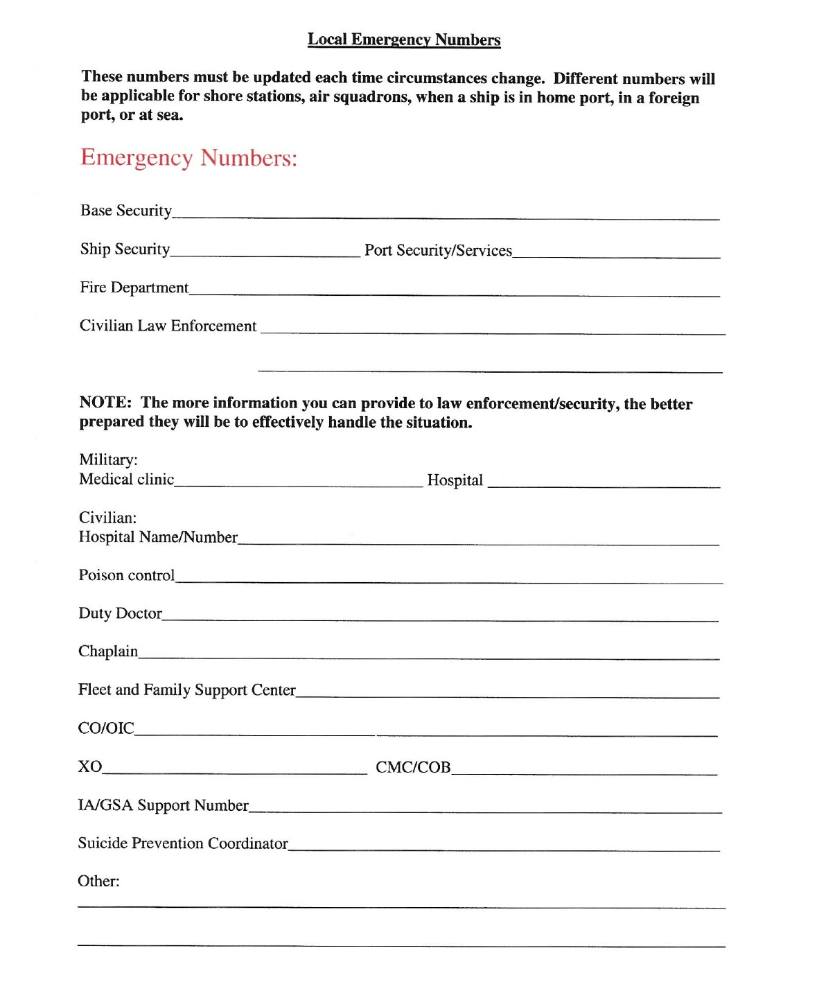
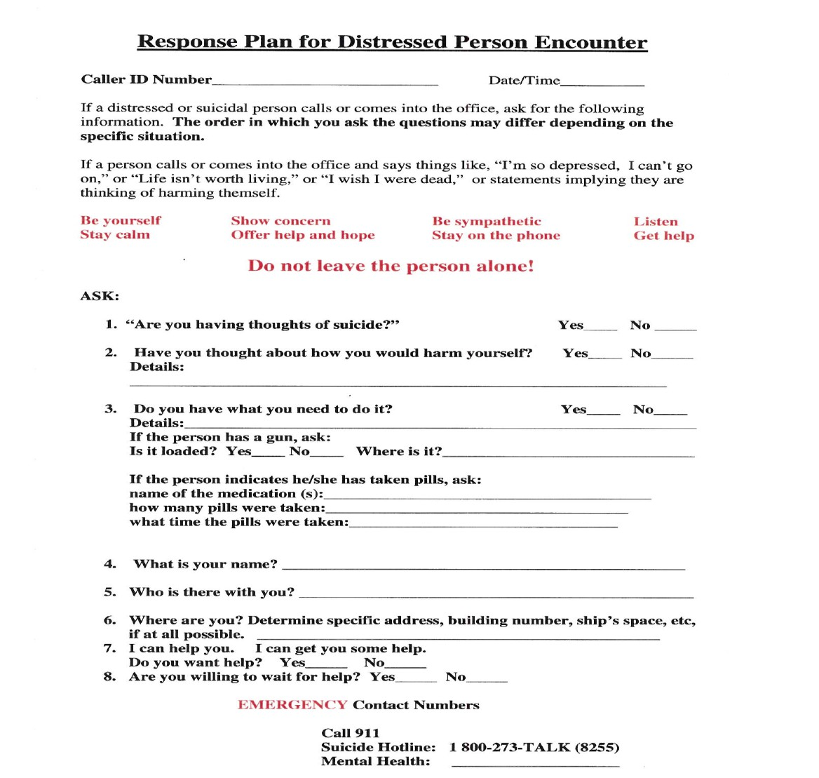
Crisis Response Plan (Example)
EXAMPLES
See the full Suicide Related Behavior Response & Prevention Guide on MyNavyHR

Slide 18

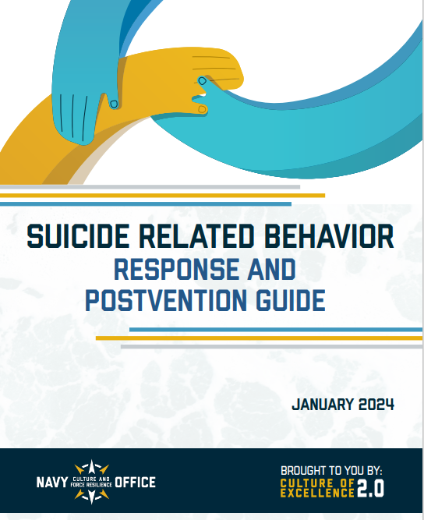
Reintegration Considerations
After a Sailor receives psychological health treatment and is fit for duty, reintegration must be done carefully to promote Sailor’s continued health, reduce negative perceptions within command and reduce impact on other vulnerable Sailors.
Refer to these resources for additional guidance:
Ensure a warm hand-off between the medical provider and command leadership.
CO should maintain communication with Sailor and providers during treatment and reintegration process.
Ensure that leaders, peers, and medical are ready to help. Type of injury is not as important as recovery progress and Sailor’s ability to perform required duties.
In some cases, reintegration back into civilian world is best. Maintain communication with Sailor and, if possible the family, during transition to minimize risk and promote ongoing success.
Reinforce seeking help as a sign of strength. Seeing a shipmate return as a respected, contributing member of the unit after receiving treatment may increase the chances that others will seek help when needed.
Mental Health Playbook
Suicide Related Behavior Response & Prevention Guide

Slide 19
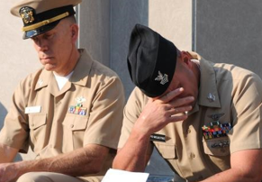
Postvention: After a Death by Suicide
“Postvention” describes actions that are taken after a suicide to help those affected by the loss. You can refer to the Postvention Guide on https://www.mynavyhr.navy.mil/
Losing a shipmate to suicide is one of the most difficult situations Sailors may face.
  Those left behind may experience immediate or delayed emotional reactions including perceived guilt, anger, shame or betrayal; no two people will grieve the same.
  Finding balance between the grief process and mission demands can be challenging. Sailors impacted by suicide must be given same considerations as Sailors who lose a Shipmate by other causes.
  Postvention can serve as “psychological first aid.” Risk is doubled for a unit after a suicide or attempt. Command messaging after a loss is critical. Consult with Medical or Chaplain.

Slide 20
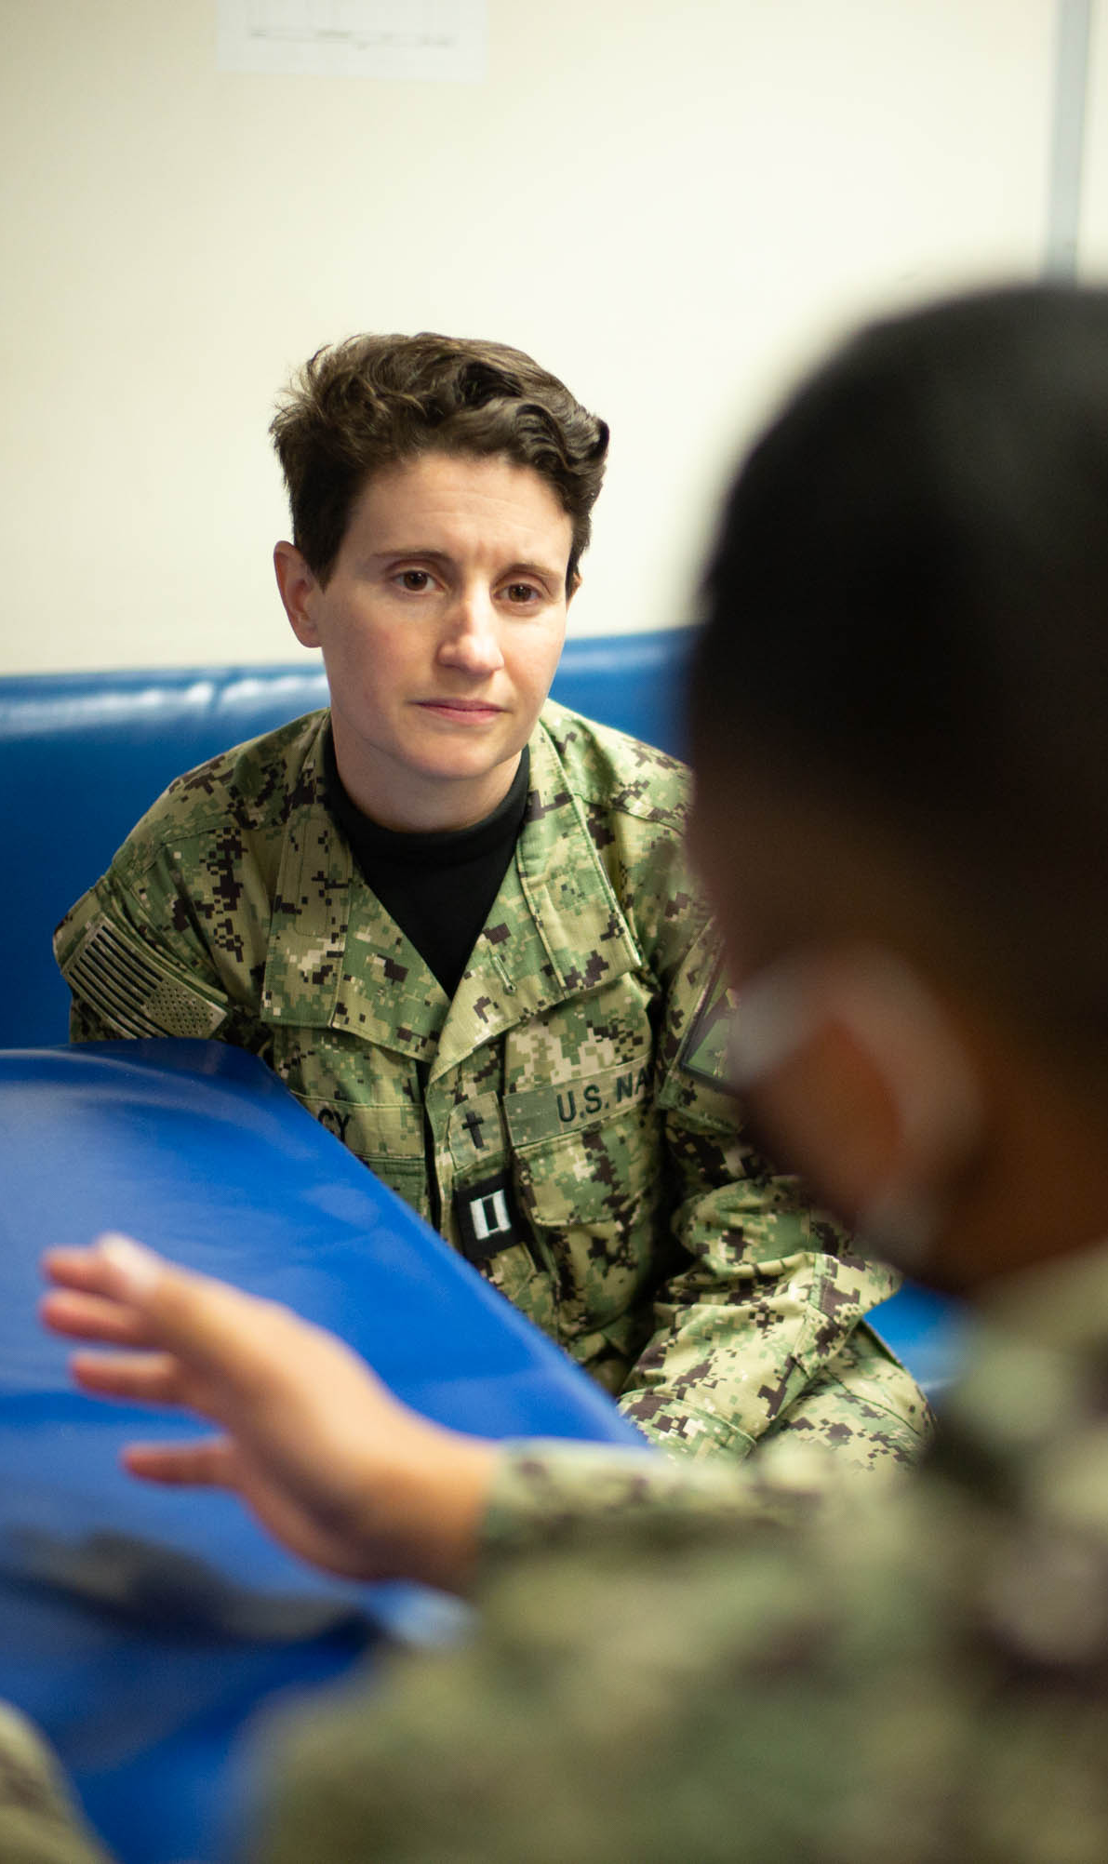
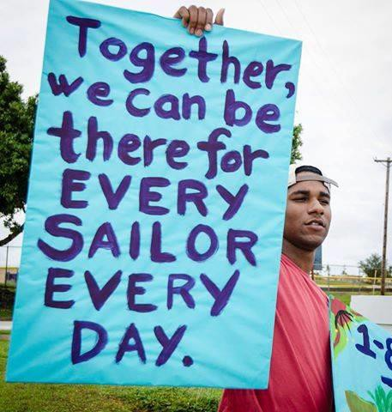
Resources for Sailors
Local Resources
  Chain of command for support, mentorship, and guidance
  Chaplains: 100% confidentiality, CREDO, premarital & marital counseling, spiritual guidance and support
  Fleet and Family Support Centers (FFSCs): counseling, classes, education, support programs
  Primary Care Manager and Primary Care Mental Health Provider—Integrated Behavioral Health, assessments, and treatment
  Local Vet Centers: 100% confidential, not in VA or TriCare records. Call 1-877-WAR-VETS (927-8387)
  Military Family Life Counselors (MFLC): MilitaryOneSource.mil
  Tragedy Assistance Program for Survivors (TAPS): 800-959-TAPS (8277)
  Give an Hour: https://giveanhour.org
National 24/7 Resources
  Military OneSource: 1-800-342-9647
  Veterans’ Military Crisis Line: 988, Press 1
Notes:
Deleted safe helpline

Slide 21
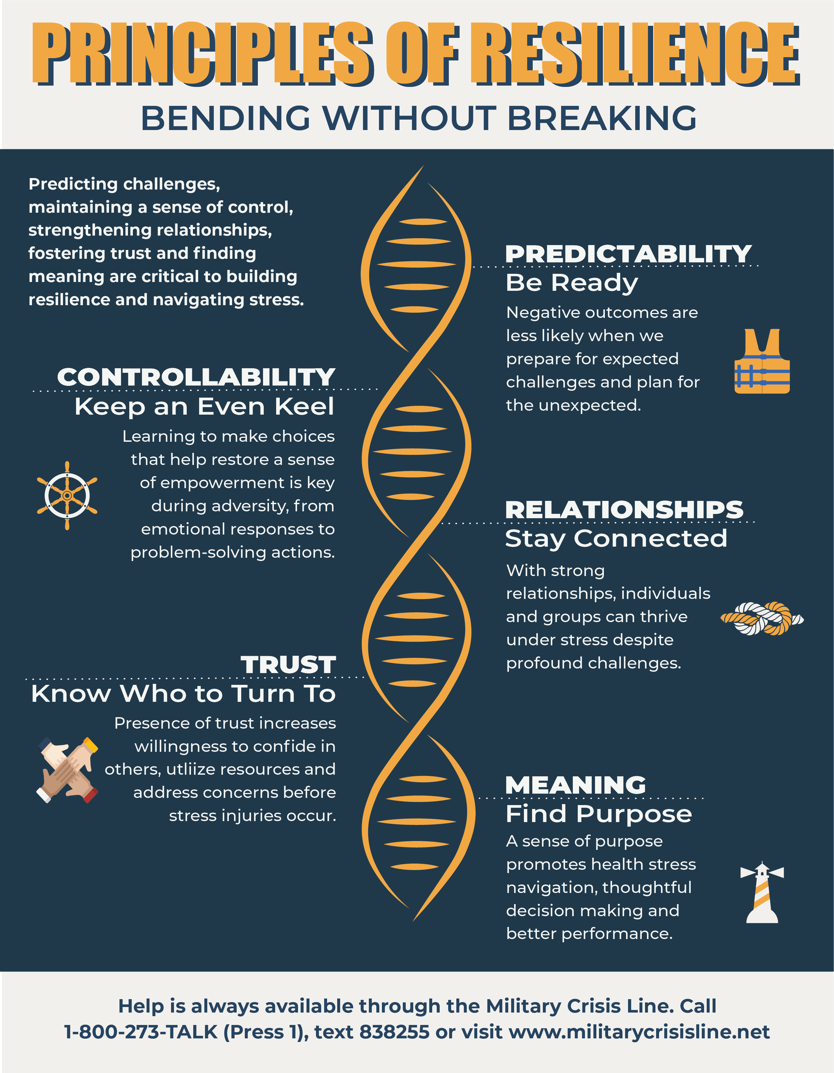
Additional Resources
General Suicide Prevention Resources
  Navy Suicide Prevention: www.suicide.navy.mil
    Contact information
    Facts and warning signs
    Informational products and resources
  Suicide Prevention Resource Center: www.sprc.org
  Defense Suicide Prevention Office: https://www.dspo.mil/
Navy Stress Control Resources
  Mental Health Playbook: https://www.mynavyhr.navy.mil/Support-Services/Culture-Resilience/Leaders-Toolkit/Mental-Health-Playbook/
Notes:
Add DSPO? ADD MHPB?
[Nicole]: Added both
We like this but have no idea where to put it in the presentation. Thoughts?
[Nicole 20 JUL]: Added the PoR graphic y’all liked to this additional resources slide, thoughts?
(Leah) GREAT WORK!

Slide 22
Sailor Assistance and Intercept for Life (SAIL)
Training for Suicide Prevention Coordinators
UNCLASSIFIED

Slide 23

Sailor Assistance and Intercept for Life (SAIL)
The SAIL Program is an intervention strategy that provides rapid assistance, ongoing risk management, care coordination and reintegration assistance for Sailors identified with an SRB. Participation is completely voluntary.
SAIL:
Supplements but does not replace mental health treatment providing continuous contact throughout the first 90 days after a suicide related behavior.
Applies evidence-based tools—the Columbia Suicide Severity Rating Scale (C-SSRS) and Veteran’s Administration Safety Plan (VA Safety Plan)—to monitor the needs of and provide additional resources to Sailors who accept the program.
Promotes a collaborative relationship with healthcare providers and command leadership
Facilitates the coordination of additional resources for Sailors beyond medical intervention to promote ongoing recovery and success.

Slide 24
SAIL: Things you should know
Commands are responsible to refer all Sailors who experienced SRBs to the SAIL program per NAVADMIN 027/17. Participation in SAIL services is entirely up to the Sailor.
SPCs are responsible for submitting SAIL referrals.
Only the assigned SAIL Case Manager can offer participation and conduct caring contacts.
Details about the Sailor’s SRB or other circumstances are not included in the SAIL referral and are not shared with the SAIL Case Manager.
Providers, leaders and Command Resilience Team members should be knowledgeable about SAIL so that they can encourage Sailors to accept the services.
WHY SAIL?
Previous suicide-related behavior (SRB) significantly increases the risk of future suicide.
In 2016, Approximately 40% of Sailors who died by suicide had a previous SRB.
Maintaining contact with and coordinating care services for individuals who have exhibited an SRB can prevent future suicide ideation and attempts.

Slide 25
SAIL Reporting Requirements
A | OPREP/SITREP DTG
B | Date of Incident
C | Sailor's Last Name
D | Sailor's First Name
E | Sailor's Middle Initial
F | Sailor's Rank
G | Sailor's Work Phone
H | Sailor's Email Address
I | Sailor' personal cell number
J | Sailor's Current Location (City, State, Country)
K | For Reserve Component Sailors only, indicate status: (FTS, SELRES on orders, SELRES not on orders)
L | Base/Installation
M | Region
N | Command
O | Region
P | Commanding Officer's Name
Q | Commanding Officer's Phone
R | Commanding Officer's Email​
S | Additional Information (Alt Triad's contact info, i.e., XO, CMC)
When an SRB occurs, the SPC will:
  Visit Navy Suicide Prevention’s SAIL webpage: https://www.mynavyhr.navy.mil/Support-Services/Culture-Resilience/Suicide-Prevention/Commands-Leaders/
  Click on the link titled “SAIL Mailbox”
  Submit the required information
via encrypted email to
MILL-N17-SAIL@us.navy.mil, subject: SAIL REFERRAL
The SPC should not contact the Sailor directly to obtain their information. Command administrative resources should be utilized.

Slide 26
SAIL: Things You Should Know
“After I Submit the SAIL Referral, How Do I Verify if My Sailor Has Been Contacted?”
The following link contains the SAIL POC List broken down by region: Sailor Assistance and Intercept for Life (SAIL) Contact the SAIL Case Manager within your region to verify contact. As a BEST Practice, include SAIL Case Manager contact info in CRP.
The SAIL referral is mandatory for any Sailor who experienced a suicidal related behavior.
Only the assigned SAIL Case Manager can offer participation and conduct caring contacts
Providers, leaders and CRT members should be knowledgeable about SAIL so that they can encourage Sailors to accept the services
REMEMBER: “Ask. Care, Treat!”

Slide 27
Sending Encrypted Mail to the SAIL Mailbox
If experiencing problems sending a SAIL referral via encrypted email:
Go to website: https://dod411.gds.disa.mil
Enter the SAIL email link: MILL-N17-SAIL@us.navy.mil
Click “Search”
Click on “MILL”
Click on the appropriate download link (usually: Download Certificate(s) as vCard Outlook & Internet Explorer or Netscape 7.x Required)
Select Certificate
Click “Save”
Once downloaded, open the downloaded file in Outlook so it will populate in the "To" line. Start sending encrypted emails to SAIL Mailbox
Notes:
Ultimate goal is to reduce suicides by developing resilient Sailors, supporting help seeking behaviors, better identify and support those in need
Educate and empower leaders to understand their critical role in enhancing command climate to achieve these goals

Slide 28
If Encryption Problems Continue………….
Submit the SAIL referral via DoDSAFE https://safe.apps.mil/
Please be sure to send a passphrase in a separate email.
Notes:
Ultimate goal is to reduce suicides by developing resilient Sailors, supporting help seeking behaviors, better identify and support those in need
Educate and empower leaders to understand their critical role in enhancing command climate to achieve these goals

Slide 29
SAIL Questions
Please contact OPNAV N170B if you have questions regarding the SAIL Program.
NAVY SUICIDE PREVENTION PROGRAM
Office: (901) 874-6613
Email: MILL-N17-SAIL@us.navy.mil

Slide 30
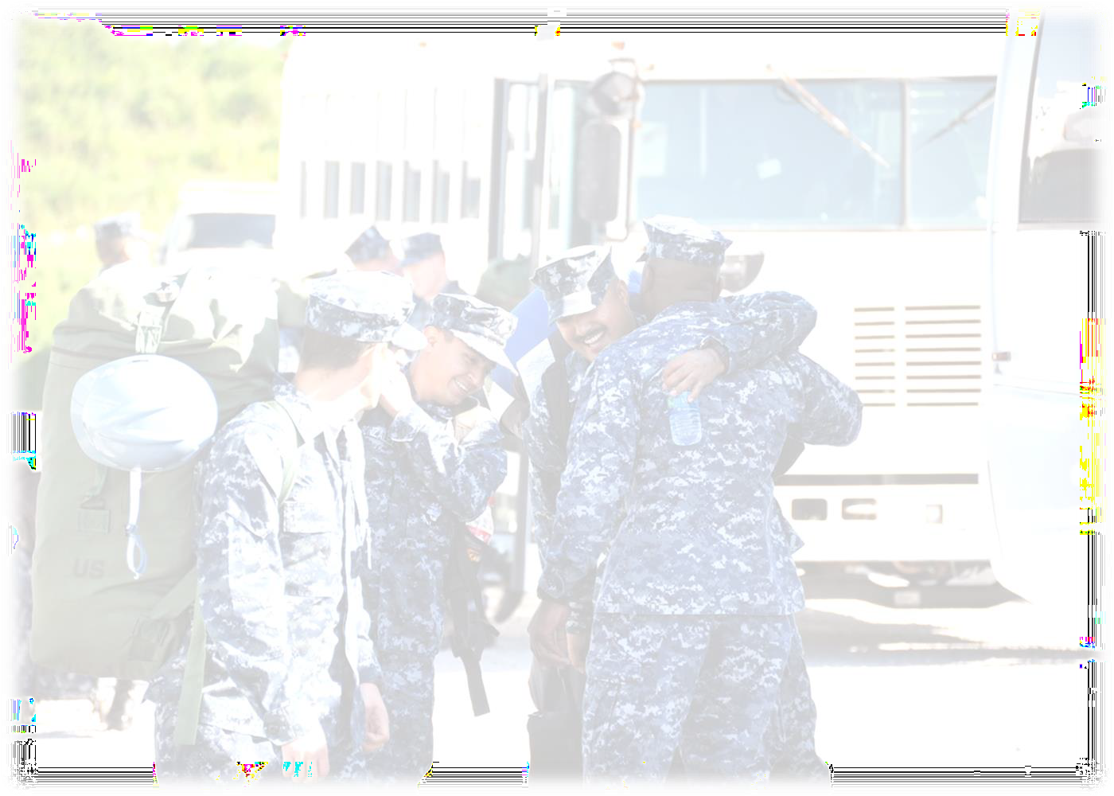
It’s about being there for Every Sailor, Every Day
Questions

